Slide 1
Predicting Accident Severity
Applied Data Science Capstone

Slide 2
Predicting Accident Severity
Early warning weather systems present around the world work to alert the population of an impending disaster.
The application of the same concept on a much smaller scale to predict the probability of an accident and it’s severity from prevailing weather conditions could be valuable in preventing accidents

Slide 3
Data acquisition
The particular dataset used for this model is UK Road Safety : Traffic Accidents and Vehicles sourced from Kaggle.
Link : https://www.kaggle.com/tsiaras/uk-road-safety-accidents-and-vehicles
The dataset comprises of two files :
AccidentInformation.csv: every line in the file represents a unique traffic accident (identified by the Accident_Index column), featuring various properties related to the accident as columns. Date range: 2005-2017
Vehicle_Information.csv: every line in the file represents the involvement of a unique vehicle in a unique traffic accident, featuring various vehicle and passenger properties as columns. Date range: 2004-2016
The two above-mentioned datasets can be linked through the unique traffic accident identifier (Accident_Index column).

Slide 4
Cleaning the data
All rows with null/empty of values out of range (-1)were dropped.
The classes of Serious and Fatal Accidents were combined into one composite class ‘Serious or Fatal’.This was done because less than 2% rows had data on Fatal Accidents
Downsampled dataset to approx 650000 rows from 2 million due to processing power constraints.

Slide 5
Feature Selection
With an iterative process of Visualization and modelling, the following features were finally chosen:
Light Conditions
Road Surface Conditions
Weather Conditions
Road Type
Sex of Driver
Day of the Week
Speed Limit
Driver Age Band
Urban or Rural Area
Junction Detail
Vehicle Type

Slide 6
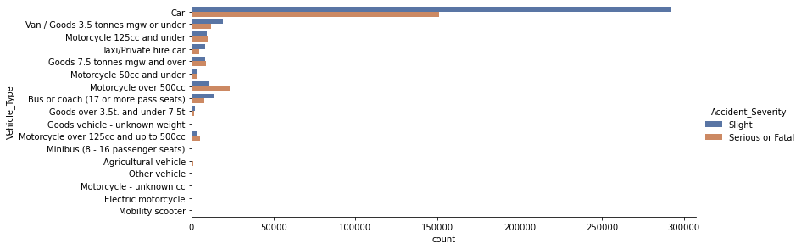
Feature Optimization
Some features selected for the model, have categories with a degree of overlap. While these features are highly specific, the result of having several narrowly defined categories leads to each category having comparatively less training data on each category. The distribution of data available for Vehicle type shows how each category has limited data.

Slide 7
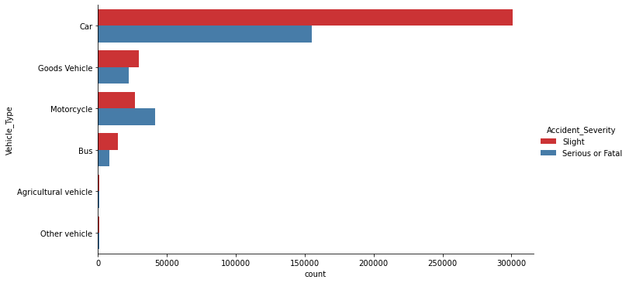
Combining the specific categories into a more general category whose definition encompasses all the sub-categories yields a more simplified distribution. A similar process is carried out on all the other selected features, to optimize them towards better model performance.

Slide 8
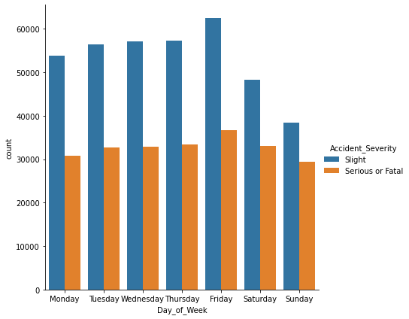
Observed Trends in Selected Features – Day of the Week
The distribution of accidents over the days of the week illustrates that a higher number of accidents occur on the weekdays compared to the number of accidents occurring on Saturdays and Sundays,i.e, the weekend.

Slide 9
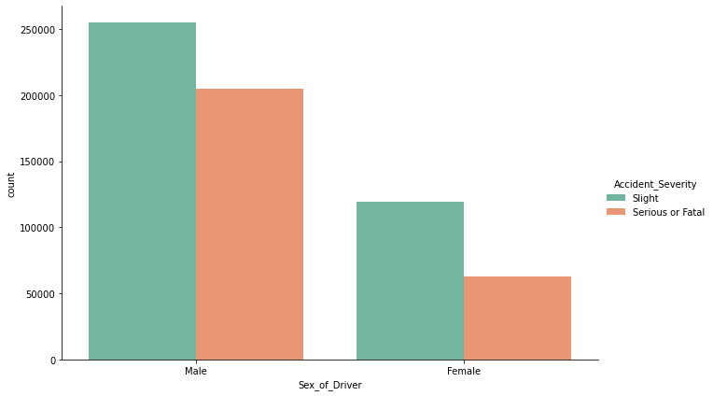
Driver Gender
Accident severity distribution against the sex of the driver illustrates that Men are more likely to get into an accident compared to women.

Slide 10
Vehicle Type
The graphical data shows that motorcycle accidents tend to be more serious or fatal compared to slight accidents.

Slide 11
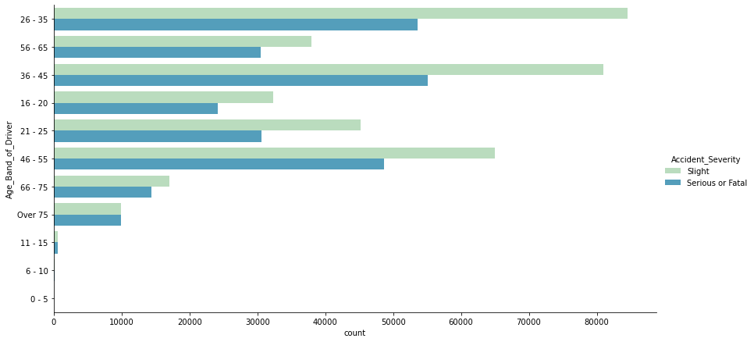
Driver Age
Plotting Accident Severity v/s Driver Age Band shows that drivers aged 26-35 have the maximum number of collisions

Slide 12
Measuring Model Performance
Model | Precision | Accuracy | F1 score | Jaccard Score
Random Forest Classifier | 0.61 | 0.62 | 0.60 | 0.53
K Nearest Neighbour | 0.58 | 0.60 | 0.57 | 0.54
Logistic Regression | 0.62 | 0.62 | 0.62 | 0.49
Decision Trees | 0.62 | 0.62 | 0.62 | 0.50

Slide 13
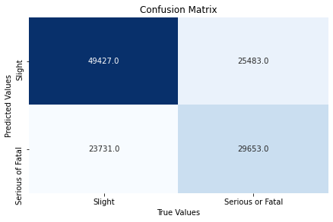
The Decision Tree classifier model has yielded the best results as given by High F1 and Jaccard scores relative to other models used.
On the left,we have the confusion matrix for the model,showcasing True Positive,True Negative,False Positive and False Negative values.

Slide 14
Conclusion and Future Work
Analysed the relationships between local weather data, environment data and vehicular and driver data and it’s impact on accident severity, built a model to predict the Accident Severity along with it’s probability.
To improve the model's performance, we could narrow our field of study to a smaller region in the UK, a city preferably and work on predicting accident severity for that smaller region and include locally relevant attributes.
Accuracy of the models has room for improvement. Additional Data on average traffic flow and concentration needed.
Location specific trends and data from applications like Google Maps and Waze, accident hotspots can be identified a mitigating measures can be taken by the Road and Transport Safety organizations.

